Slide 1
Dates for your diary
Tuesdays 2pm weeks 2-4: Tech session C317
Friday October 18: NO CLASS
Friday November 1: CLASS (this won’t be in the timetable)

Slide 2
Tech sessions from week 5
9am-11am Monday Oct 21: Tech session C312
No tech session week 6
2-4pm Tues Nov 5: Tech session in C285
9am-11am Mon Nov 11 in C312
9am-11am Tues Nov 19 in TV Studio P020

Slide 3
What we will cover
Pre-production
Production
Post-production
Idea generation (wk 2)
Story-led research (3)
Interview planning (4)
Filming/recording (tech sessions)
Interviewing (5)
Drafting (6)
Further research (3/7)
Editing (7)
Editing for the web (8)
Editing for social (9)

Slide 4

MED7334 Narrative
from media to interactive media

Slide 5

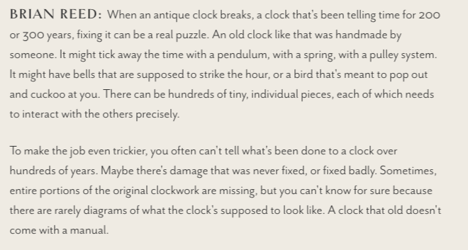
Listen: S-Town
https://stownpodcast.org/chapter/1
Notes:
S-Town is a compelling setting, and the story hinges on a compelling, unusual character. The question the structure raises is: where is this going? What’s the movement? If you listen carefully you can guess what’s going to happen.

Slide 6
What I’ll cover:
What makes a story (narrative)
The problem with stories
Tips for your story

Slide 7
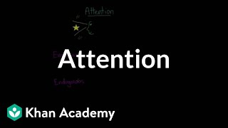

Slide 8
Switch on Airplane Mode.
Close your laptop.
Don’t be passive.
Notes:
In 20 years our average attention span has dropped from two and a half minutes to 47 seconds (from 2024 to 2021)

Slide 9
Chapter 1:
What are we talking about?

Slide 10
Discuss: What is a (good) story?
Your suggestions here…

Slide 11
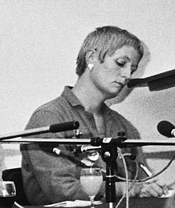
Meet Mieke Bal.
Notes:
This is Mieke in 1980, age 34, five years before she published Narratology: Introduction to the Theory of Narrative. She then became Professor of Semiotics and Women’s Studies at Utrecht University (1987–1991). She has published more than thirty books on a wide range of subjects and is a video artist whose films and installations have been exhibited internationally

Slide 12
Defining narrative
Should contain an actor and a narrator*;
3 distinct levels: the text, the story, and the fabula;
Contents should be “a series of connected events caused or experienced by actors.”
Mieke Bal, quoted in Helen Fulton’s Narrative and Media
*Actor and narrator can be same; narrator can be ‘effaced’

Slide 13
Fabula vs stories vs texts
Snow White has a series of elements [fabula]: events, characters, places, times
Multiple stories can be created by choosing and ordering those in different ways (content) (e.g. Snow White & the Huntsman, Mirror Mirror)
Multiple texts can be created by telling any story using different media, etc. (film version, book, animation, audio)

Slide 14
Applying theory to practice
We choose elements (“fabula”) and order them into a story. We then tell that story in one or more video/ article/podcast/carousel/thread... (the “text”)
Knowing that, we can start to focus on each stage and learn how to do those things better.

Slide 15
In groups, list elements for:
You are making a travel program about Uganda
You are interviewing a 19-year-old woman tech entrepreneur
You are writing a news story about a 15-year-old boy who has gone missing

Slide 16
Chapter 2:
The problem with stories

Slide 17
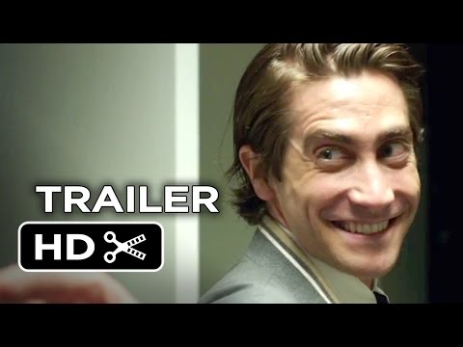
[Nightcrawler: Script, Analysis]

Slide 18
There’s a problem with stories!
“Attention to the textual conventions of a genre helps scholars attend to narratives as both the products of standardised routines and evidence of broader cultural forces at play.”
Buozis & Creech 2017
Notes:
...But if we don’t use narrative techniques, research suggests that people do not engage with stories, or remember them.

Slide 19
FRANK Joel’s got a source in the sheriff’s department who says they’ve found drugs at the Granada Hills house. Cocaine in wrapped packages hidden in a crawlspace. Over 50 pounds. He’s confirmed it with an investigator at the scene. It wasn’t a home invasion, it was a drug robbery.
NINA Give it to the noon crew.
FRANK This is news.
NINA It detracts from the story.
FRANK It is the story.
NINA The story is urban crime creeping into the suburbs. Innocent victims. That’s the story.
1hr50m: “That’s the story”
[Nightcrawler: Script, Analysis]

Slide 20
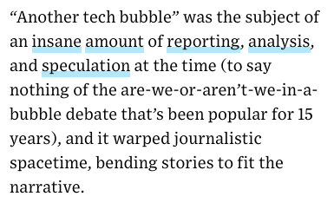
The “Law of narrative gravity”
“The more widely accepted (or massive) a narrative, the more it attracts and shapes the perception of facts.”
Grosser 2017
Notes:
...But if we don’t use narrative techniques, research suggests that people do not engage with stories, or remember them.

Slide 21
“In the case of the “Migrant Crisis”, the overarching metanarrative - that the number of refugees entering the UK constitutes a “crisis” - dictates the type of media which is produced on the issue.
“Barthes described this phenomenon as the creation of “de-politicised speech” (2017:4), whereby the language used by the media (e.g. “Migrant Crisis”) “achieves the status of myth [and] their political context falls away” (2017:5). Ultimately, whether or not migration constitutes a “crisis” is a matter of subjective political judgement.”
Nathan Clarke, Research in Practice assignment (2021)
Notes:
We need to be aware of generic habits in order to think of other ways of telling stories

Slide 22
“The Blame Frame affixes responsibility on human agents and foregrounds the pursuit of punishment and justice. The Explain Frame takes responsibility away from human agents and describes the tragedy in terms of natural or quasi-natural processes.
“The study argues that social identities of “prospective” agents predict the difference in framing: “deviants” and “aliens” are held culpable while local elites are deemed innocent, although these identities are themselves social and draw on prevalent cultural beliefs. Ultimately, both frames serve to reproduce social boundaries and reinforce the status quo.”
Shahin 2015
Notes:
We need to be aware of generic habits in order to think of other ways of telling stories

Slide 23
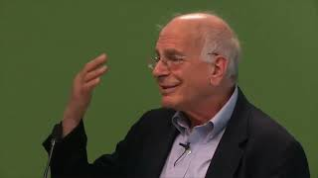
‘Coherent stories’ (Kahnemann 2011)
We dismiss or fail to seek out information that doesn’t ‘fit into’ a story
We see intention and agency where none exists
We confuse causality with correlation
We make more of coincidences
Hindsight bias: we ‘knew it all along’
https://thedecisionlab.com/thinkers/economics/daniel-kahneman
Notes:
“Declarations of high confidence mainly tell you that an individual has constructed a coherent story in his mind, not necessarily that the story is true

Slide 24
Crime & terrorism stories
“Use values that favour conflict over clarity and opinion over explanation. “The desire ... to tell a story may end up so disregarding statistical patterns that they end up misinforming our view of the world.”
Cushion, Lewis & Callaghan 2017
Notes:
...But if we don’t use narrative techniques, research suggests that people do not engage with stories, or remember them.

Slide 25

“There is evidence of bias in media coverage in Canada and Australia suggesting the media reports mostly focus on white people who go missing, preferably a pretty white woman or girl from a middle or upper class background. This racial bias has been termed as the missing white woman syndrome.”
https://www.port.ac.uk/news-events-and-blogs/blogs/democratic-citizenship/why-racial-bias-dominates-coverage-of-missing-person-cases

Slide 26
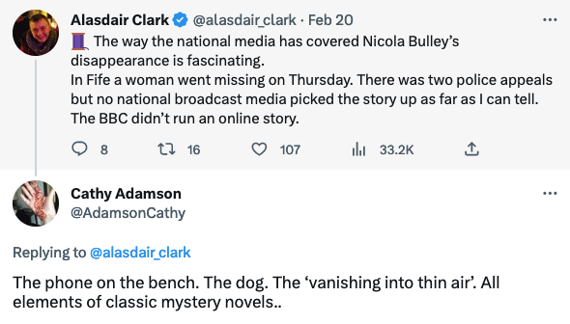

Slide 27
Can you think of an example?
In groups, discuss what the law of narrative gravity might be for:
A documentary about Twitter/X
An interview with an up-and-coming musician
A 15 year old boy has gone missing
The Government proposes a new policy to reduce migration
Interviews with those affected by floods in India

Slide 28
But we still need stories
“In a direct comparison with expository text, narrative text was read twice as fast and recalled twice as well, regardless of topic familiarity or interest in the content itself” (Dahlstrom 2014)

Slide 29
“[Personified] stories and stories with photographic images stimulated the strongest emotional impact, while use of mobilising information (telling audiences how they could act to make a difference) and statistical information were found to have only a small effect on reader reaction. The straight “just the facts” story elicited the weakest reader response of all.” (Maier 2016)

Slide 30
“There is a deep gap between our thinking about statistics and our thinking about individual cases. Statistical results with a causal interpretation have a stronger effect on our thinking than noncausal information. But even compelling causal statistics will not change long-held beliefs or beliefs rooted in personal experience. On the other hand, surprising individual cases have a powerful impact and are a more effective tool for teaching psychology because the incongruity must be resolved and embedded in a causal story.”
Daniel Kahnemann, Thinking Fast And Slow
https://thesciencept.com/because-you-know-im-all-about-that-base/

Slide 31
The Nisbett and Borgida experiment
“Subjects’ unwillingness to deduce the particular from the general was matched only by their willingness to infer the general from the particular.”
https://thesciencept.com/because-you-know-im-all-about-that-base/

Slide 32
‘Melodrama’ “increases recall” (but “not comprehension”)
‘Narrative news’ “elicited stronger affective and cognitive involvement” (but not recall); made “better informed” young readers (but lower satisfaction)

Slide 33
Counter-narratives are narratives too
‘Missing white woman syndrome’ is a narrative too: while studies outside the UK support it, UK data challenges it (note: not the same as disproving it): 80% of missing people are white vs 61% of media appeals. 14% of missing people are black vs 22% of media appeals.
(But that’s not the whole story either: “The bias is not just in the amount of coverage, but also in the content and quality – which stories make the front page, how many words per article and what language is used.”)
Green 2021
Notes:
...But if we don’t use narrative techniques, research suggests that people do not engage with stories, or remember them.

Slide 34
Conspiracy theories are narratives
“My TikTok "For You Page" had been awash with videos speculating about Nicola's disappearance … in recent days, these widened out to include conspiracy theories suggesting the disappearance has been staged by the government or other sinister forces.”
Marianna Spring 2023
Notes:
...But if we don’t use narrative techniques, research suggests that people do not engage with stories, or remember them.

Slide 35
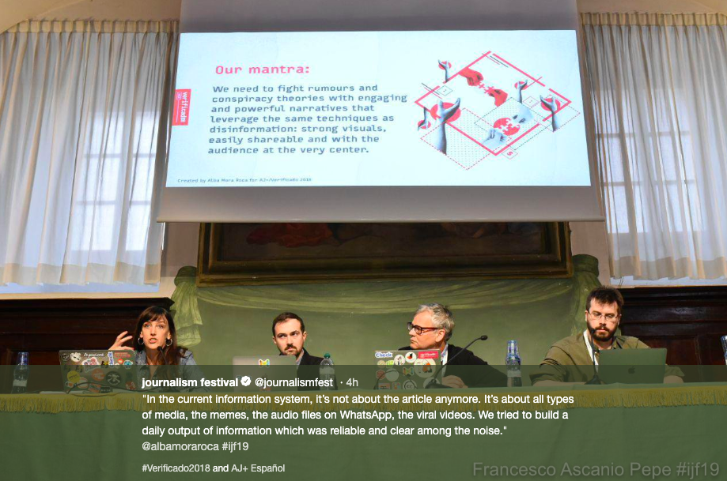
Competing with misinformation?

Slide 36
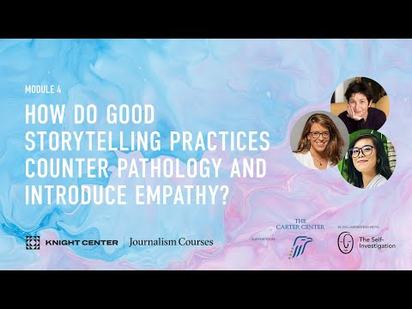

Slide 37
Chapter 3:
Tips

Slide 38
For example: choosing elements
Identify characters: do we want to know more?
Identify settings: where does the action take place? (Umwelt)
These provide physical or emotional movement (e.g. chemistry, conflict, seeking, avoiding)

Slide 39
How to reference this
I made a list of the elements — or fabula (Fulton 2012) — in the story.
Bibliography
Fulton, Helen (2012) Narrative and Media, Cambridge University Press

Slide 40
Chapter 4:
The result

Slide 41
Key points
Narrative concepts can be useful tools when developing a story idea or adapting to new platforms and genres
We are natural storytellers - don’t fool yourself it’s “just the facts”, there’s always subjectivity involved
Think critically about narrative to ensure you use it appropriately and avoid cliches (eg the law of narrative gravity)

Slide 42
Coda:
What happens next?

Slide 43
Subscribe…
World Builders newsletter by Nathan Baugh
Like Stories of Old (YouTube channel)
How I Write by David Perell (Spotify/YouTube)
Gangrey podcast
The Sunday Long Read newsletter (longform)

Slide 44
Directed study part 1: reading
Helen Fulton, Narrative & Media ch1-2 (on Moodle)
Essential for your assignment - do it before planning your story as it should shape your production
Other suggestions: pinboard.in/u:paulbradshaw/t:research+narrative

Slide 45
Directed study pt 2: Critical analysis
Watch, listen to, or read a piece of media from your field (you don’t have to watch/listen/read the whole thing, just enough to get started with this exercise).
Make notes about the editorial choices
Consider alternative editorial choices
Be critical, be practical
Publish your notes on Medium.com if you can!

Slide 46
Examples by previous students
You’ll find analyses by previous students in the Narrative publication on Medium
E.g. Documentary analysis; film; drama;
E.g. Radio documentary;
E.g. Data-driven story; scrollytell; data video; journalism

Slide 47
Glossary
See Moodle for a glossary covering a range of narrative concepts

